Slide 1
Discovery of novel camelid germline immunoglobulin alleles
Qile Yang, Ben Murrell

Slide 2
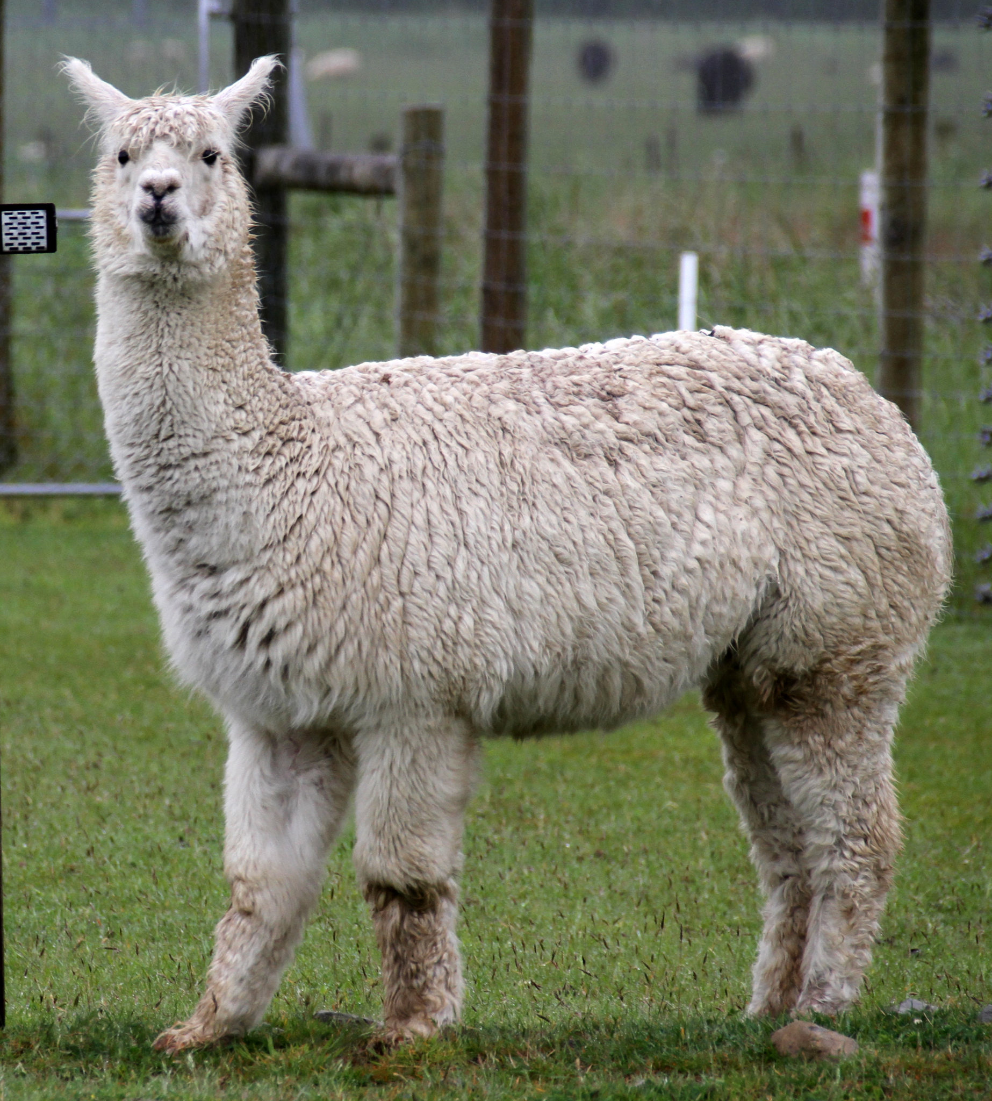
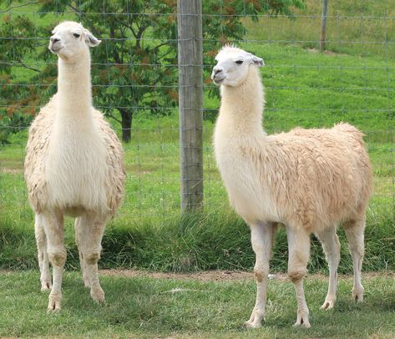
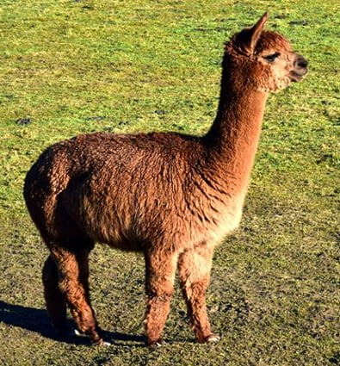
Background - Camelids

Slide 3
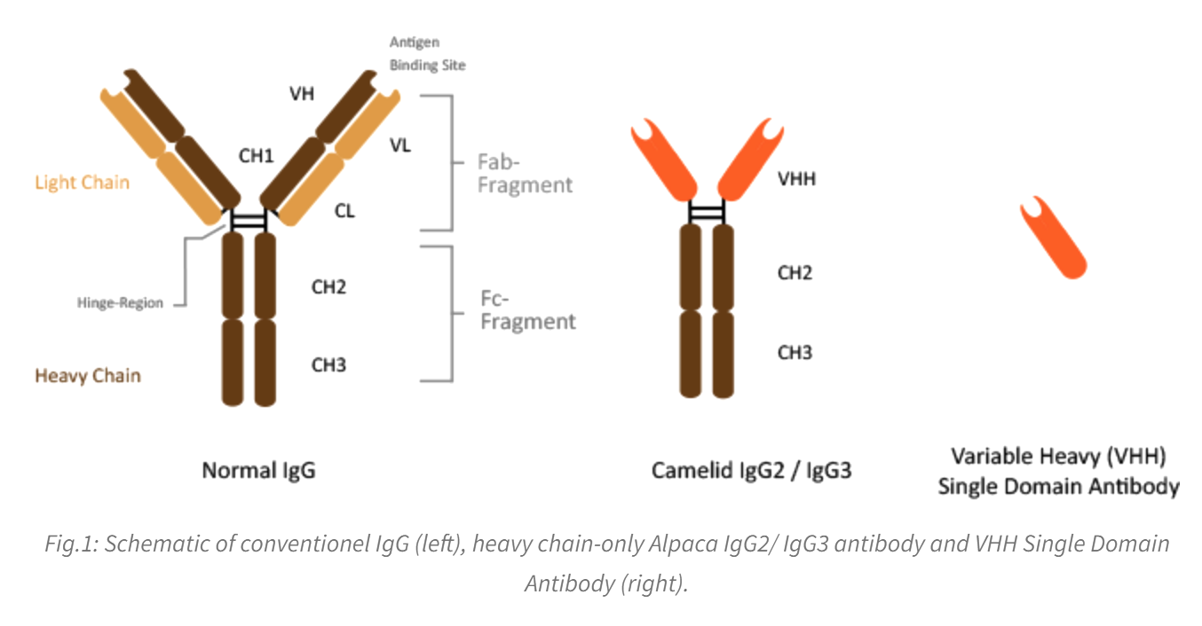
Background - antibody, isotypes, and nanobodies
Immunoglobulins (Ig) are b cell glycoproteins, also known as antibodies, that are the secreted forms of B cell receptors responsible for binding to pathogen antigens as part of the immune response
Binding site affinity depends on structure of the Antigen Binding site
Camelids possess Heavy chain only antibodies, and some of them can form single-domain antibodies (sdAb), also known as nanobodies
Antibody Isotypes differ by a few different constant regions structures, which have different effector functions
Notes:
When a precursor b cell arises, a random combo of germline genes is used to make a BCR sequence which goes on to replicate from there. One of the reasons we are interested is because these bits can be used in many studies bc convience

Slide 4
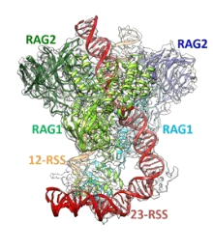
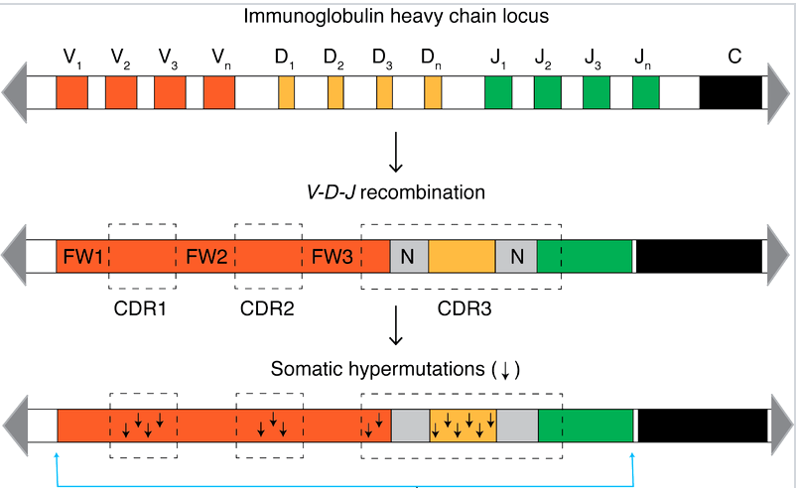
Background - VDJ C genes, V(DJ) recombination, Somatic Hypermutation
VDJ-C genes code for antibodies
VDJ recombination occurs in precursor B cells in the bone marrow
->Antibody Diversity
Randomly creates unique germline B cell sequences within B cells
From these cells, additional SHMs occurs as each B cell differentiates within germinal centers to maximize variation
Only when germline is clear, can we accurately see SHM
Notes:
Genome of all other cells it looks like this bit. But in b cells they chop out these things to form antibodies. And SHM randomizes it which forms the

Slide 5
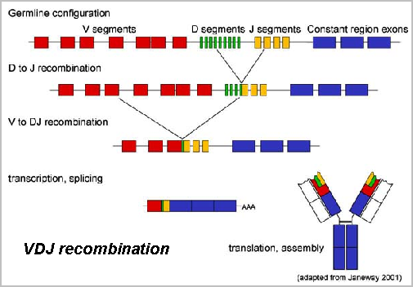

Slide 6
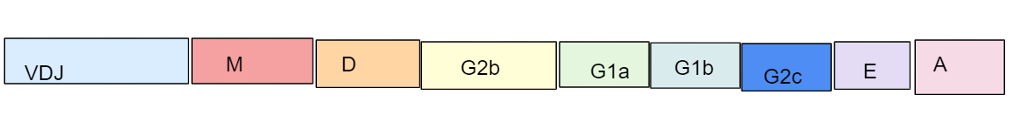
Background - Investigated Ig Isotypes
IgM = germline Isotypes
IgG2x = nanobodies w/hinge
IgG1x
IgE
IgA

Slide 7
Introduction
Current camelid V allele data bases are only made from the genomes of 2 animals.
Therefore uncovering new germline alleles is very important + for studying/synthesis of nanobodies in research/medicine
Ideally we’d have the full set of V genes for every animal that we study
How? 2 approaches
IgM sequencing methods [applies to discovering personalized germlines for each specific animal]
Genome mining [applies to discovering more germlines from public data]

Slide 8

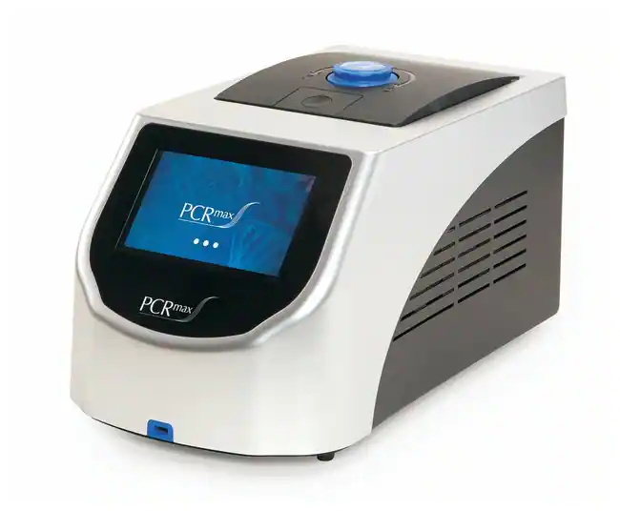
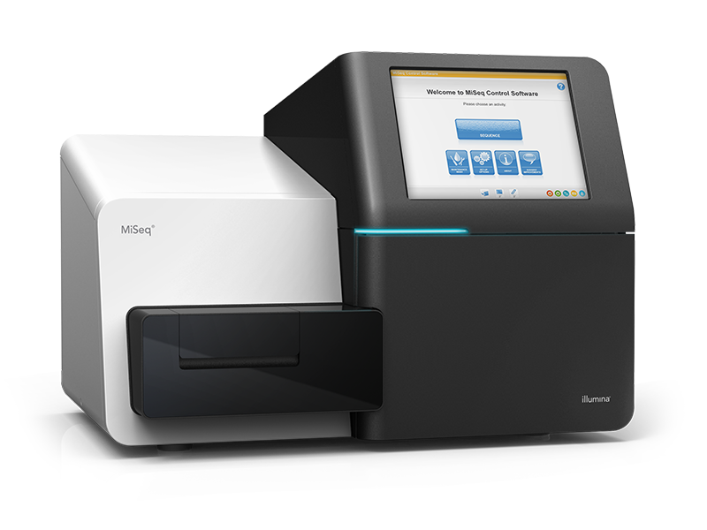
Material and methods overview: Isotype VDJ sequencing
PBMC purified RNA extracted from immunized Huarizo Dylan
RNA Leftover from the McInerney lab :)
5' RACE protocol
Pcr primer design
Reverse Transcription
Preliminary PCRs
3 rounds of PCR
Gel electrophoresis
Bead cleanup
Miseq
Post-sequencing analysis
Notes:
Kinda got into both and asked for 2 main components. Main project is VDJ sequencing and side project

Slide 9
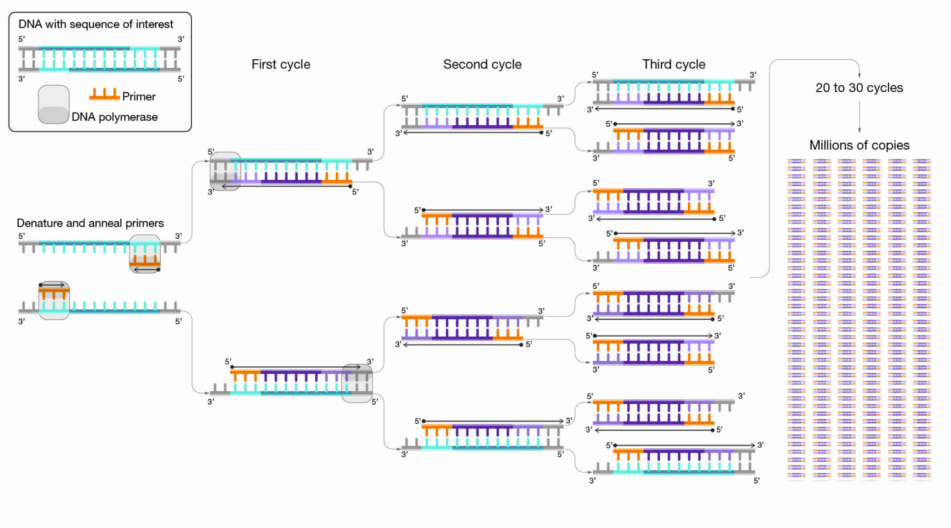
Concept: Polymerase Chain Reaction
Replicate small sample of DNA exponentially (2^C) after rounds of heating and cooling with free nucleotides and Polymerase Enzymes that detects single to double strand regions (+ other things)

Slide 10
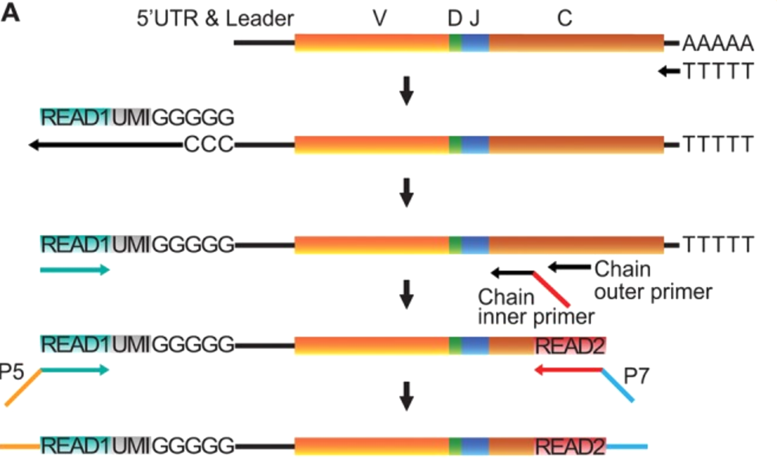
5' RACE protocol
Lack of knowledge of the 5’ end of V genes due to their variability;
First, cDNA synthesis was performed with Oligo-dT(TTTTT) and Superscript II, which yields 5′ poly-cytidine overhangs upstream of the UTR.
Next, a template switch primer (Read1_TS) containing a poly-guanosine RNA stretch of 5 nucleotides (nt) and a 12 nt UMI and a universal amplification DNA sequence identical to the Illumina's Read1 sequencing primer were added to the 5’ end for TS
Notes:
Split the image into 2 bv the first 2 is for RT. Read1 is a sequence also in overhang. The UMI is a bunch of N’s and the random atgc becomes the UMI. nonspecigic is done bc we dont know. But we knwo the C genes and they are always the same thats why we build primers there. IgM are important bc they are germline. Look at the complex paper. Talk abt the trick with the Cs due to the polymerase.

Slide 11
5' RACE protocol
Custom* Outer and inner primer attachments via 2 separate PCRs
Illumina index primer attachment via PCR 3
Bead Cleanup
Illumina MiSeq
Notes:
Split the image into 2 bv the first 2 is for RT. Read1 is a sequence also in overhang. The UMI is a bunch of N’s and the random atgc becomes the UMI. nonspecigic is done bc we dont know. But we knwo the C genes and they are always the same thats why we build primers there. IgM are important bc they are germline. Look at the complex paper. Talk abt the trick with the Cs due to the polymerase.

Slide 12
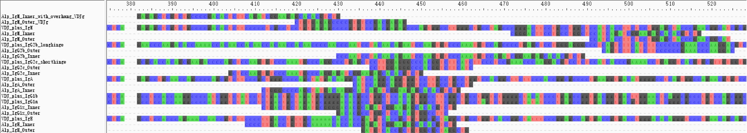
PCR primer design
Alpaca antibody (VDJ-C) sequences were stitched from online database (IMGT)
Inner & Outer primers were manually designed with 50-67% GC content, 65 - 70 °C Annealing temperature, and checked* for self & hetero dimerization with Idt Oligoanalyzer

Slide 13
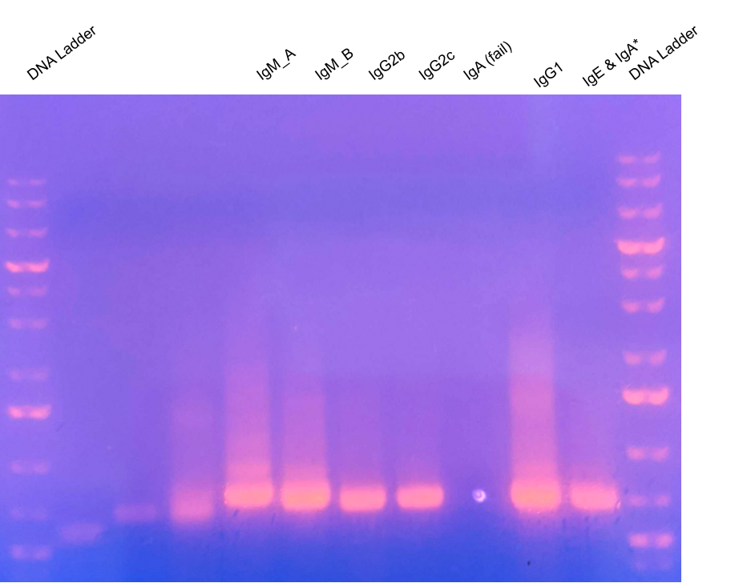
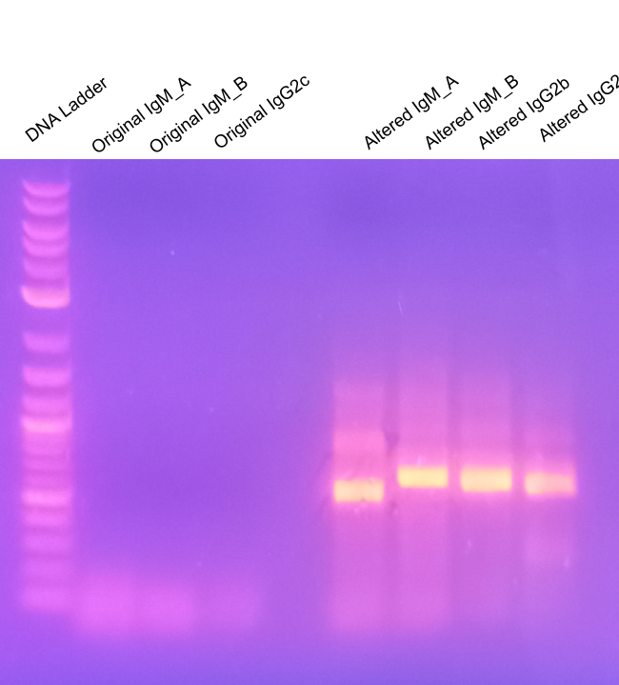
Gel Electrophoresis affirm protocol success
Figure 1: original vs Altered mixture ratios
Figure 2: confirmation of success of Index PCR
Notes:
Talk abt how iga issue was fixed with last mix

Slide 14
VDJ-C Sequencing results
66227 IgE transcripts
93973 IgG1 transcripts
33665 IgG2b transcripts
69382 IgG2c transcripts
345558 IgM_A transcripts (vdj overlap)
3357 IgM_B transcripts
275* IgA transcripts
612487 total transcripts
Only preliminary analysis was conducted due to time constraints
Notes:
Important mention: only had time to do preliminary analysis due to covid time crunch

Slide 15
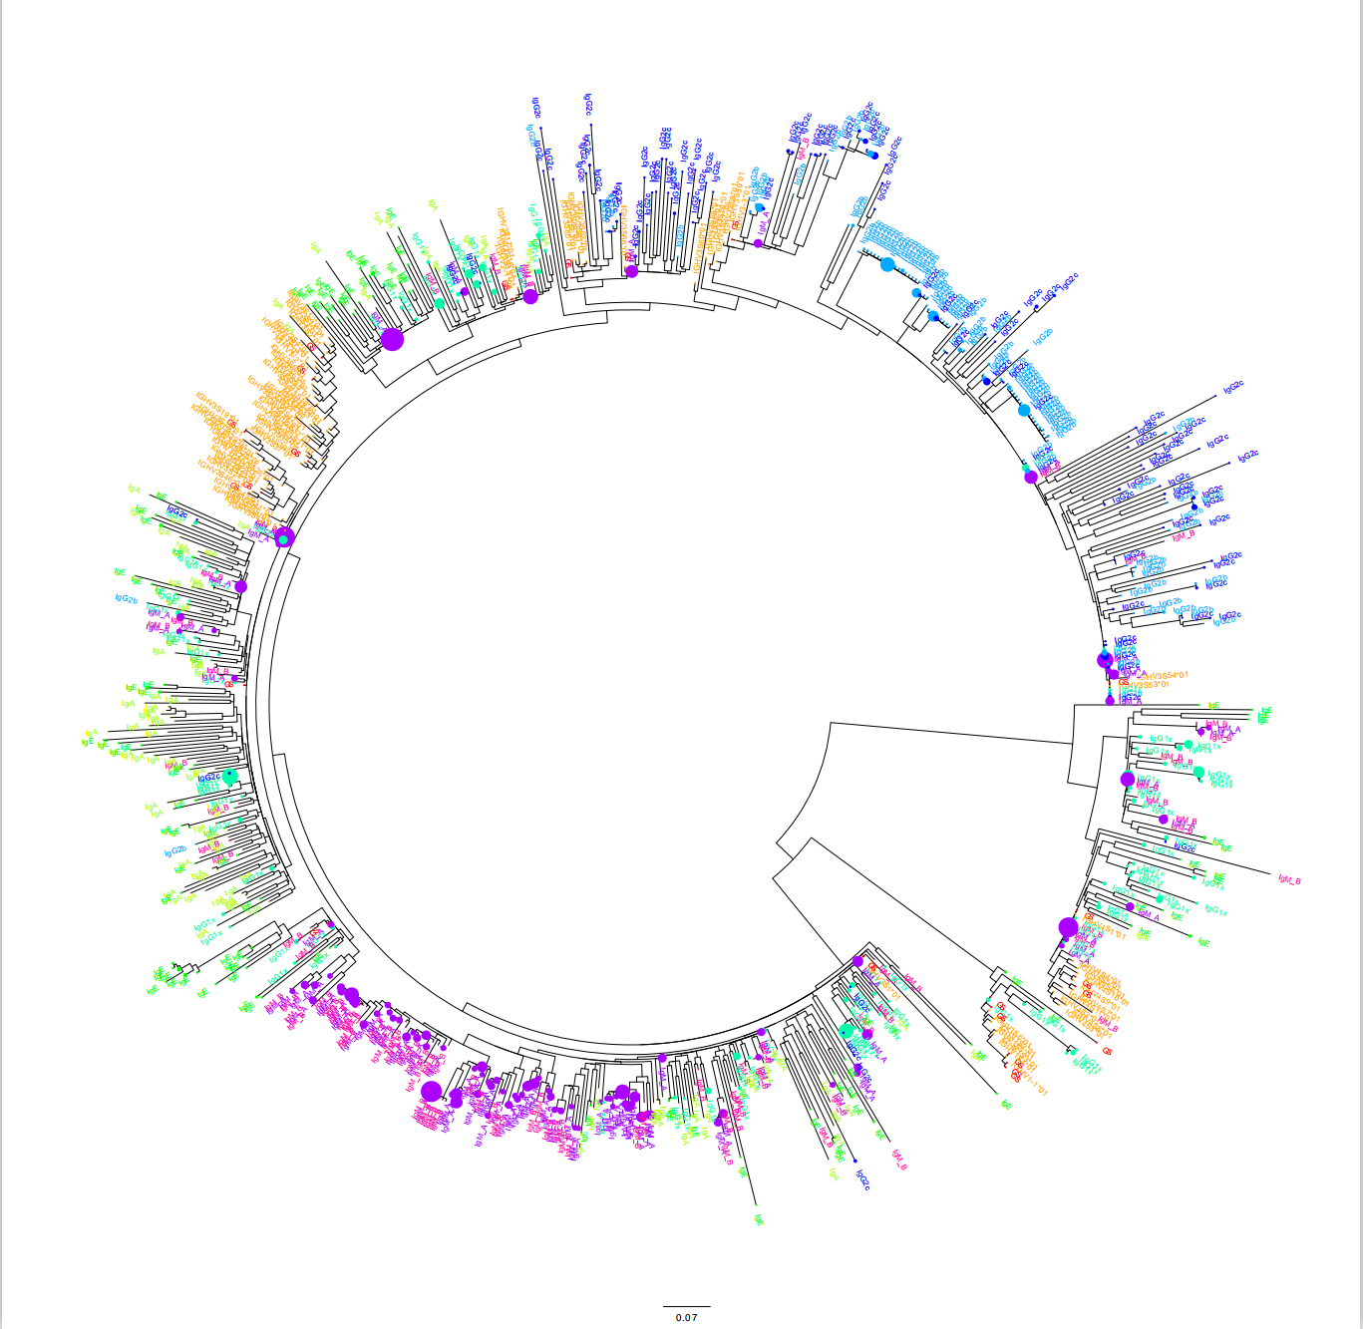
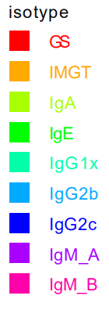
V sequencing results: overview
Circular Phylogeny of the first 285 nt of the top 100 most frequent V sequences of all Isotypes (700)
Visual inspection reveals high diversity and many unique germline allele candidates
Phylogenies are only a precursor to full analysis, and well established tools (IgDiscover) exist for confirming germline alleles.
Notes:
Clarify that later there are programs for future work. Preliminary analysis done with existing databases w distributions. Remember that IgM are germlines usually. Take specific regions of the tree and be clear that its only the first 285 nt. Its a precursor to full analysis. Important that some 2cs in conventional clade. You see handful of g1s in single domain and some mix. But not perfect but STRONG association. Send text points by tonight. Send msg abt taking seqs from the algorithm and compare to phylogeny.

Slide 16
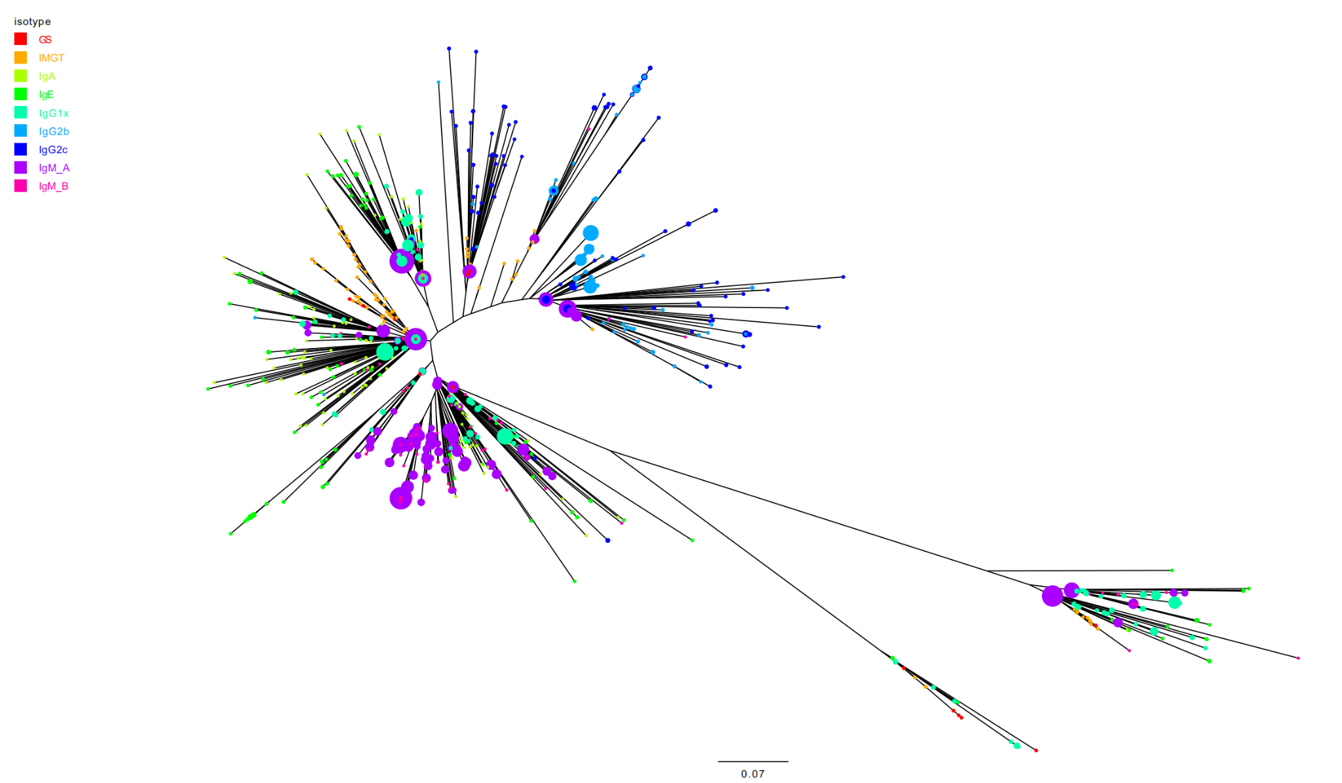
VDJ seq results
Radial Phylogeny of top 100 most frequent V sequences of all Isotypes
Circles represent the count of alleles
Notes:
Clarify that later there are programs for future work. Preliminary analysis done with existing databases w distributions. Remember that IgM are germlines usually. Take specific regions of the tree and be clear that its only the first 285 nt. Its a precursor to full analysis. Important that some 2cs in conventional clade. You see handful of g1s in single domain and some mix. But not perfect but STRONG association. Send text points by tonight. Send msg abt taking seqs from the algorithm and compare to phylogeny. We can see that we have a clade of blue on the top right that has blue sequences with SHM and IgM seqs that are less mutated. We are confirming that these sgdm antibodies pass through an “regular antibody”

Slide 17
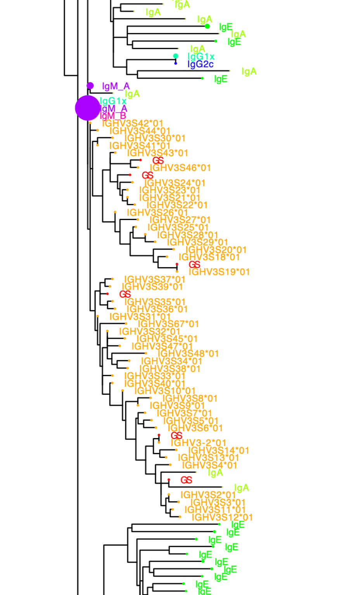
A high phylogenetic distance of a large clade of reference sequences to regular sequences strongly points to high abundance of novel alleles
A specific clade of already existing reference sequences accounting for a large part of all references are unrelated to the majority of regular Ig isotype sequences, hinting that this organism indeed presented numerous novel alleles
Notes:
We’re seeing that theres lots of alleles that are present in our database that arent found in our animal . reference seqs not real?

Slide 18
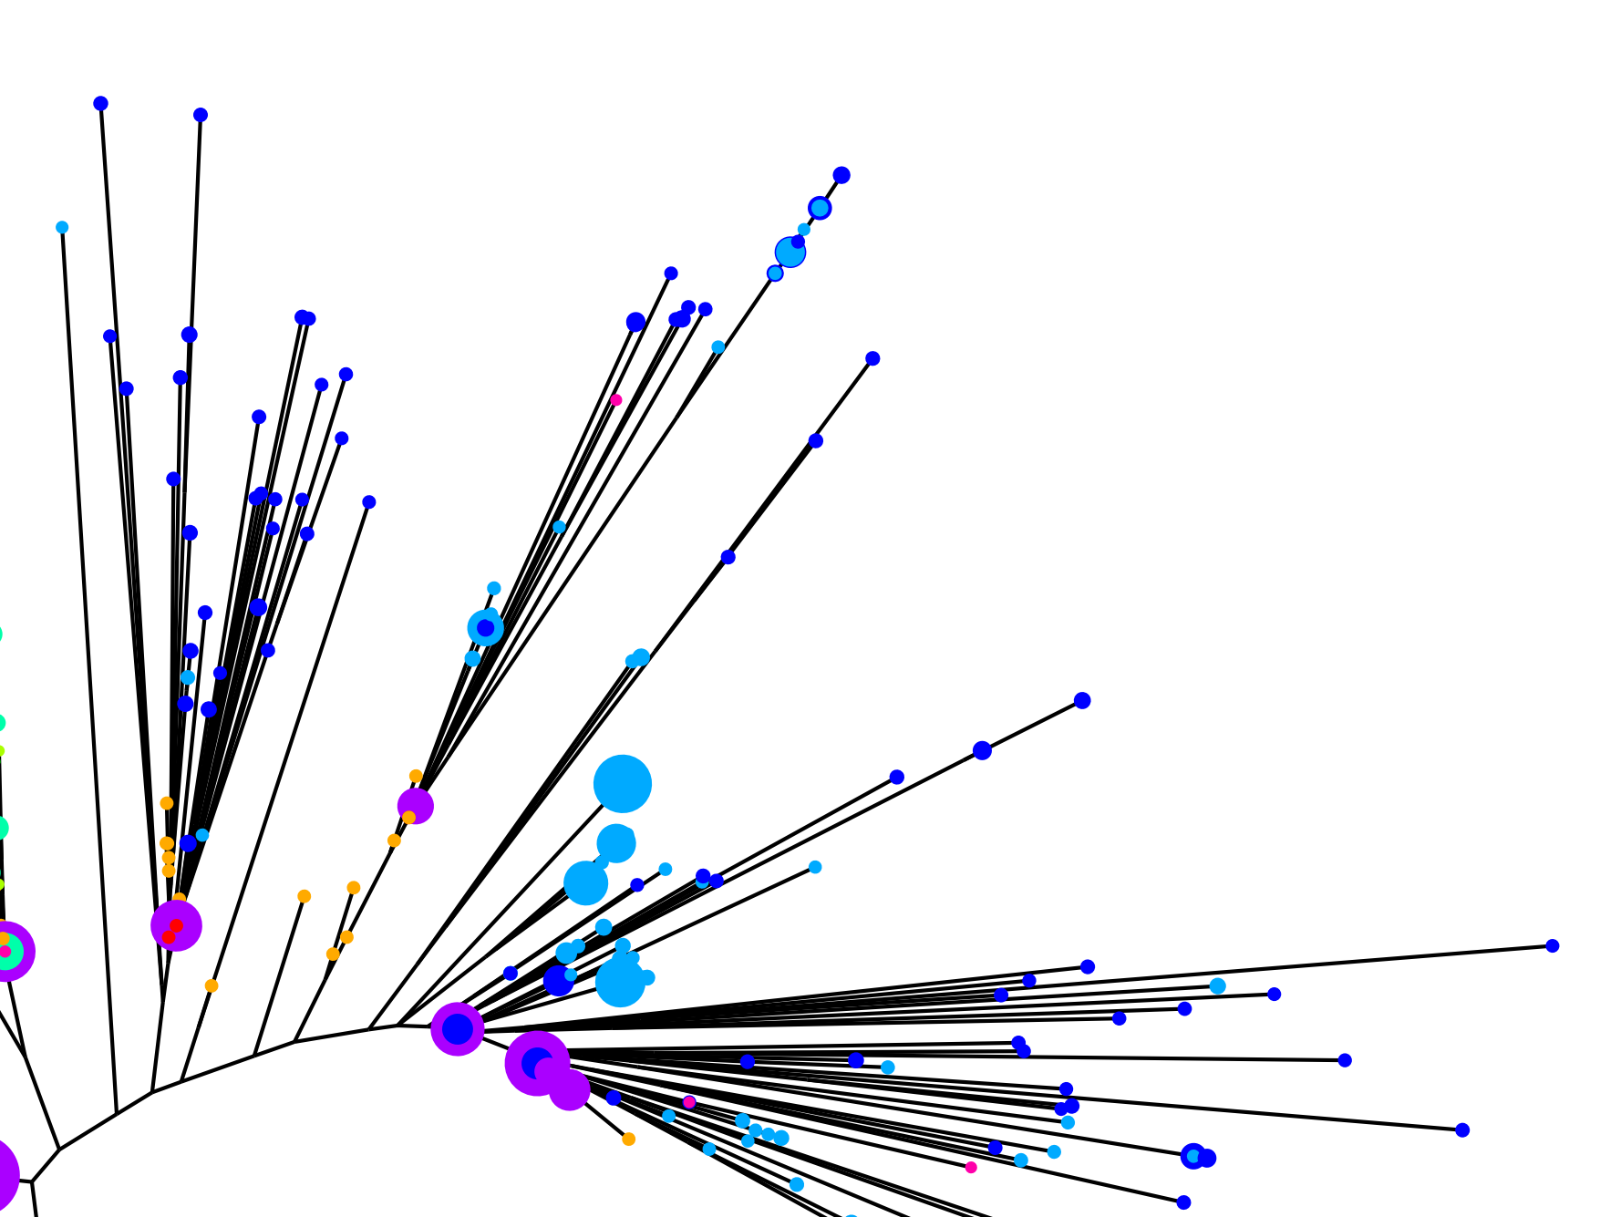
Structure of IgG2 clades reaffirms current knowledge of VDJ recomb & SHM
3-4 cell lineages clearly reveal high amounts of IgG2 isotypes arising from IgM precursors
Trace amounts of IgM present in seemingly the wrong clades

Slide 19
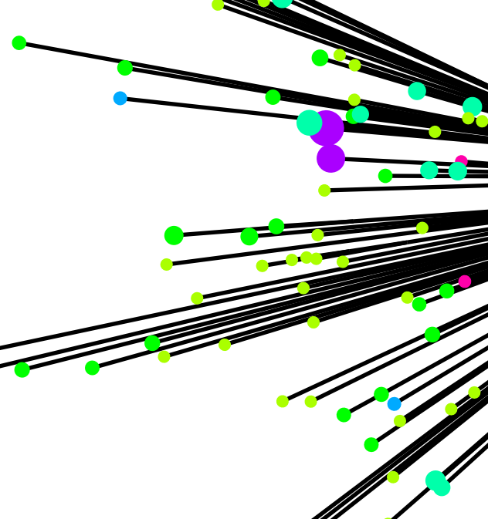
A small selection of IgG2b clades’ presence within conventional antibodies contradict current knowledge
Slightly decrease validity of data, suggesting the trend not as strong
The small selected sample size leaves little room to look deeper

Slide 20
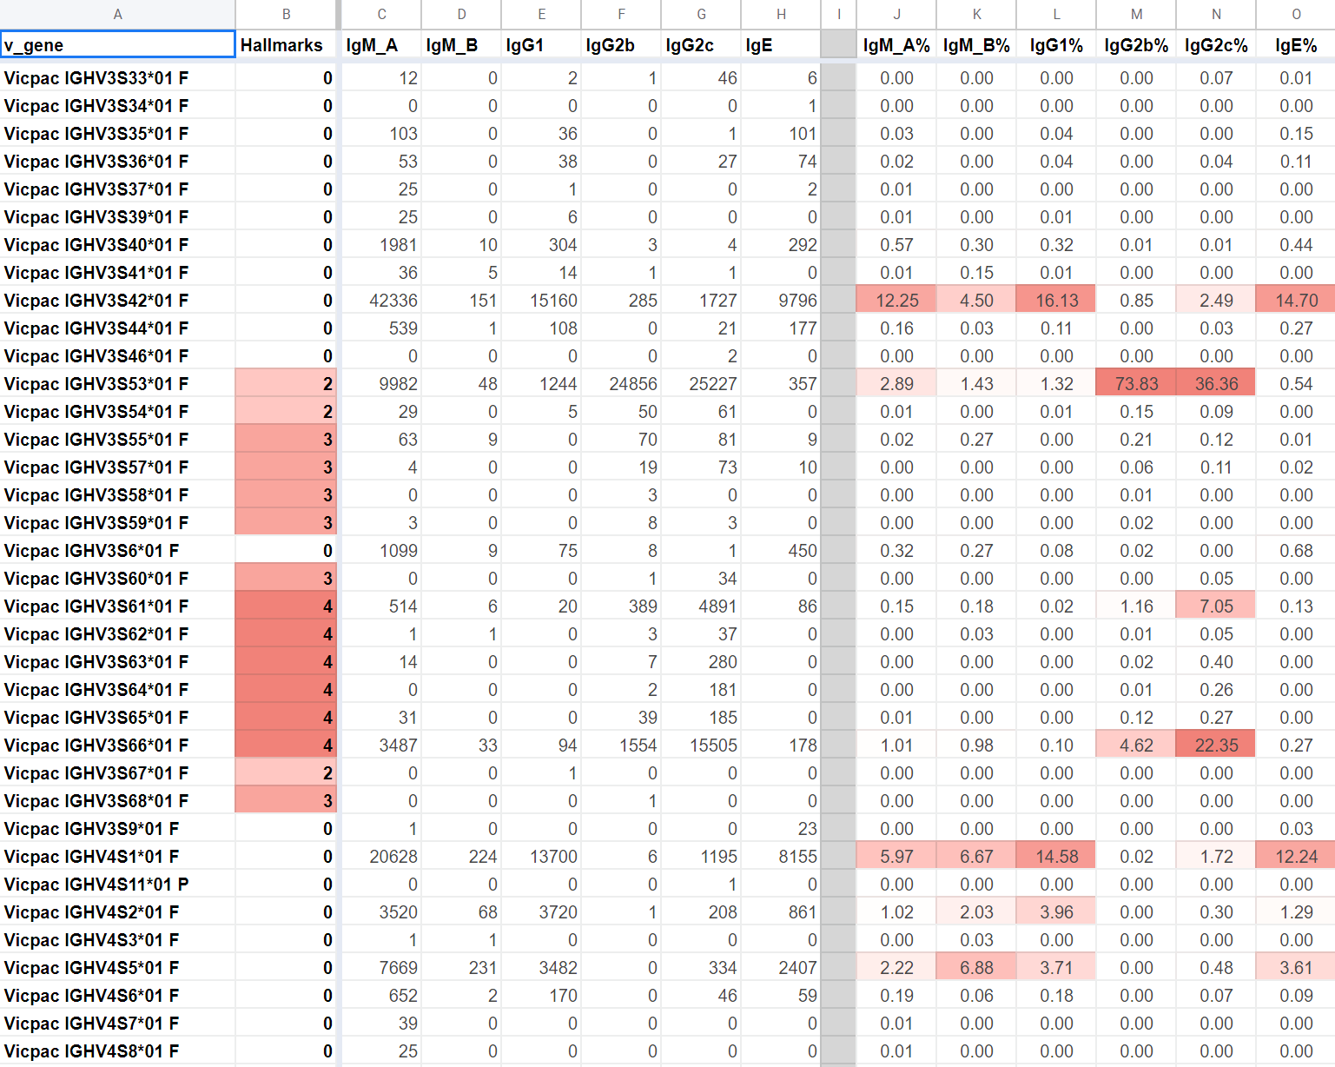
Isotype frequencies match nanobody hallmark mutations
IgG2b&c had significantly higher correlation to 4 hallmarks of nanobodies than other Isotypes, signalling that isotype distribution may be a good signal for detection of viable nanobody sequences.
A collection of previously sequenced V genes with uncertain properties can be further investigated
Notes:
Isotype frequencies match sdab hallmark mutations. When theres alot of v genes with hallmarks theres alot more igg2b and 2c . theresa paper where they are not sure if these v gene sequences are conventional antibodies or nanobodies. We can look at that with the isotype distribution bc it correlates so much to the hallmark mutations. It tells that the isotype distribution is a good signal for if something is a useful nanobody or not. It wasnt wcompletely known before

Slide 21
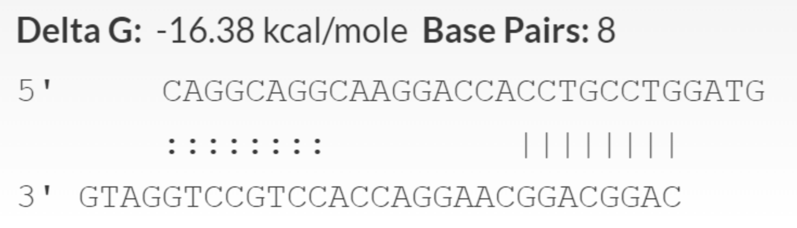
Next steps
IgA primer re-design to avoid self-dimerization
Utilisation of germline inference tools on IgM dataset for confirmation of novel alleles
Possibly scale up sampling to more animals

Slide 22
Side project: Genome Mining Algorithm & work in progress Julia package
Made while waiting for primers to arrive to look at existing genomes. Have yet to compare directly to existing tools.
Many Optimizations are possible.
Extensive testing on small datasets affirms its viability.
A fully optimized version has theoretical potential to be competitive to standard methods at the cost of accuracy/increased false positive rate

Slide 23
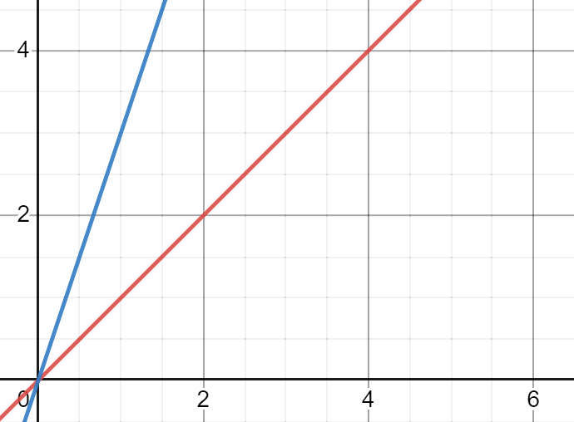
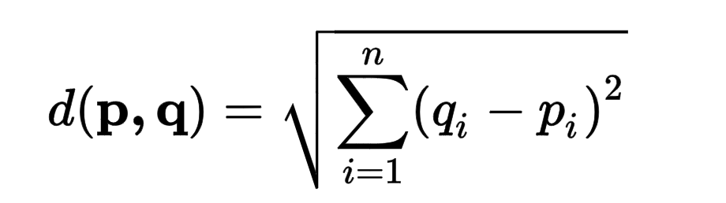
Algorithm (took away original slide)

Slide 24
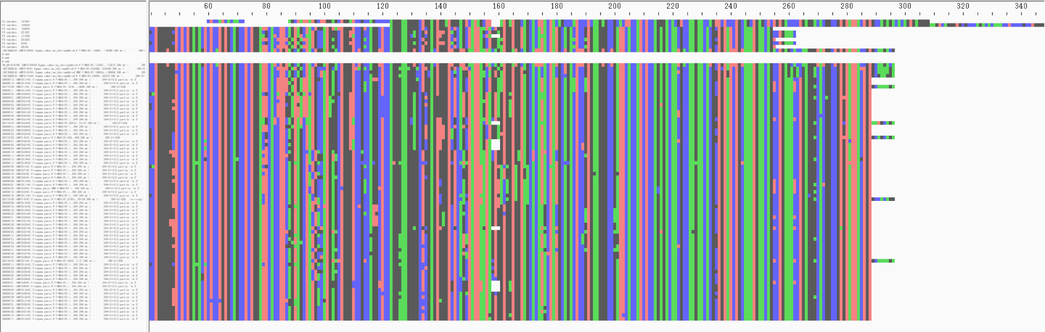
Running time: 0.20255 seconds. Predicted faster version running time: 0.085 seconds

Slide 25
Discussion
A modified 5’RACE protocol has been established
As mentioned, this was only preliminary analysis. Standard tools will be used to investigate truly all 300k IgM alleles
Even without extensive analysis with germline allele discovery tools, many trends and inferences can be drawn and serves as a good gateway to more discoveries.
A prior paper unsure about whether certain sequences are conventional antibodies now has a new front of investigation

Slide 26
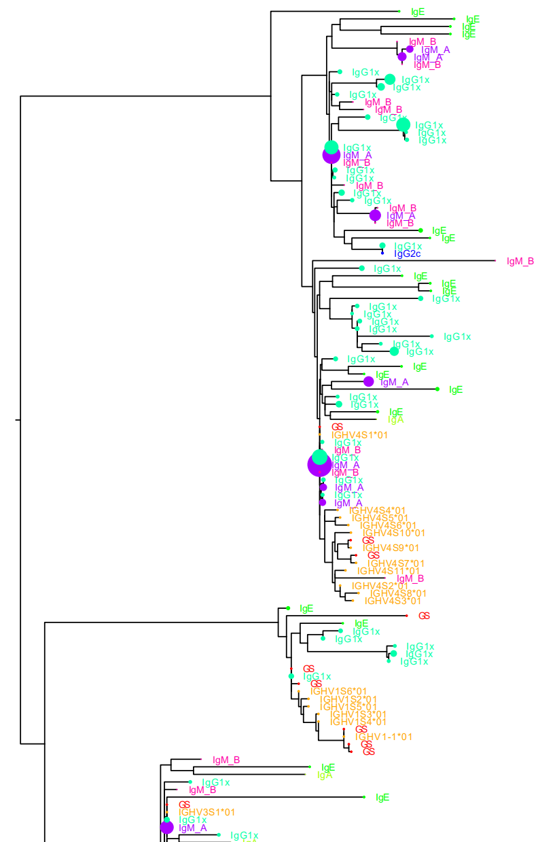
A clade of sequences unrelated to most of the sequences leaves room for investigation

Slide 27
Discussion
We will gain an increased repertoire & understanding of nanobodies, which have been employed as a research tool in many fields.
The genome mining algorithms simplicity may lead it to be less accurate than the machine learning/hidden markov based probabilistic models, produce more/less false positives, but is nonetheless proven to be viable and has potential to excel, at least in terms of speed.

Slide 28
Acknowledgements
Massive thanks to Ben for his immense dedication to simultaneously supervise the 5 of us, enduring our endless spam, even when he had Covid and many other responsibilities, and giving us the valuable opportunities to participate in the first ever CompBio Summer school!
Thanks to Daniel Sheward & Kim Chang Il for conducting, teaching, and assisting with a lot of the lab work
Thanks to Gerry, Claudia, other organizers, and the Karolinska Institute for organizing & financing SoFo 22!
Aron for helping w/my dumb coding questions & Anton for letting me borrow his charger all the time

Slide 29
Summary
1. Next generation sequencing of camelid V gene repertoire revealed ~ 300k novel IgM germline allele candidates
2. Preliminary analysis of sequenced repertoire strongly reaffirmed current knowledge of nanobodies, antibodies & has potential to answer more questions
3. In-progress development of a novel linear-time genome mining algorithm displayed potential to compete with state-of-the-art computational methods

